Slide 1

Collecting the Data

Slide 2
Objectives
Data Collection Overview
Implement the Data Collection API
Collecting the Data

Slide 3
Data Collection Overview
In this capstone assignment, we will be working with SpaceX launch data that is gathered from an API, specifically the SpaceX REST API.
This API will give us data about launches, including information about the rocket used, payload delivered, launch specifications, landing specifications, and landing outcome.
Our goal is to use this data to predict whether SpaceX will attempt to land a rocket or not.
Collecting the Data

Slide 4
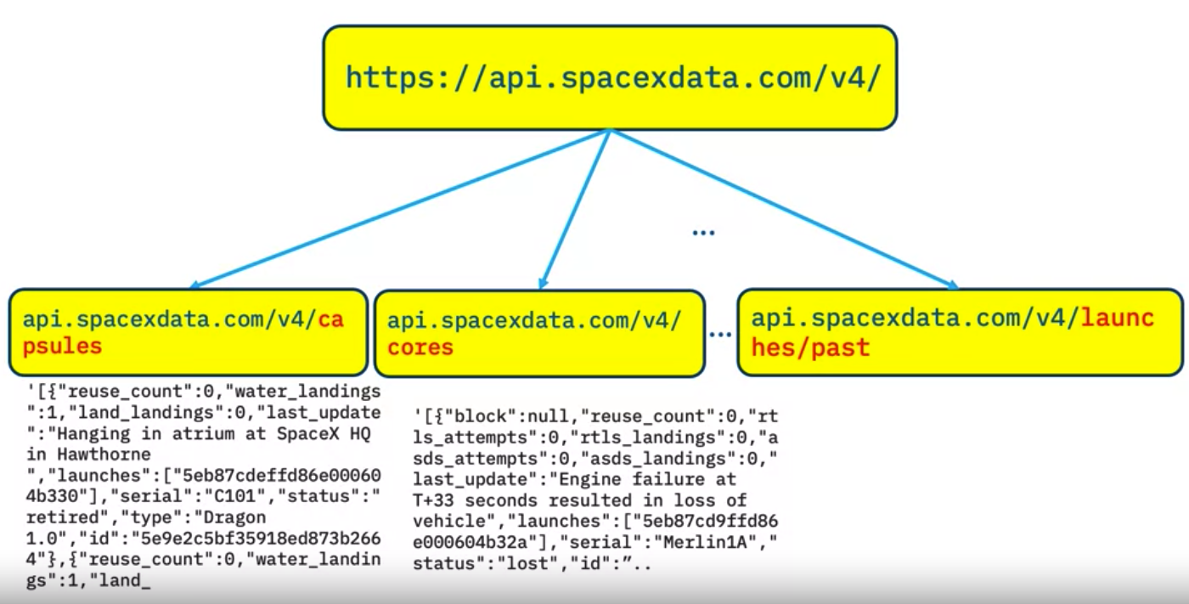
Data Collection Overview
Working with the endpoint api.spacexdata.com/v4/launches/past: get past launch data.
Collecting the Data
Notes:
The SpaceX REST API endpoints, or URL, start with api.spacexdata.com/v4/. We have different endpoints, for example: /capsules and /cores We will be working with the endpoint api.spacexdata.com/v4/launches/past: get past launch data.

Slide 5
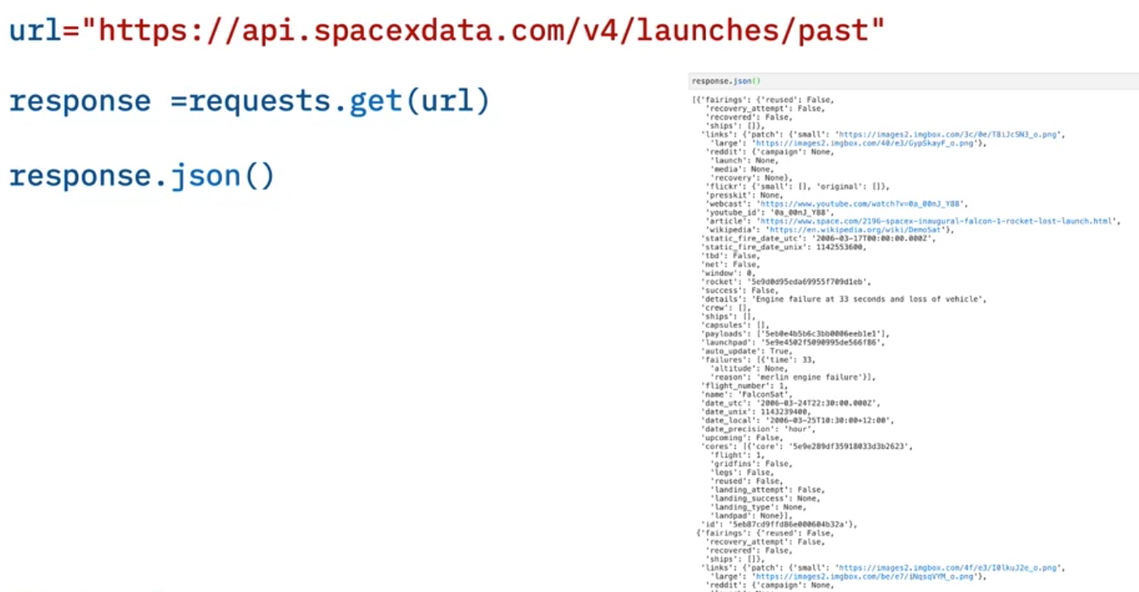
Data Collection Overview
Get data:
JSON data →
Collecting the Data

Slide 6
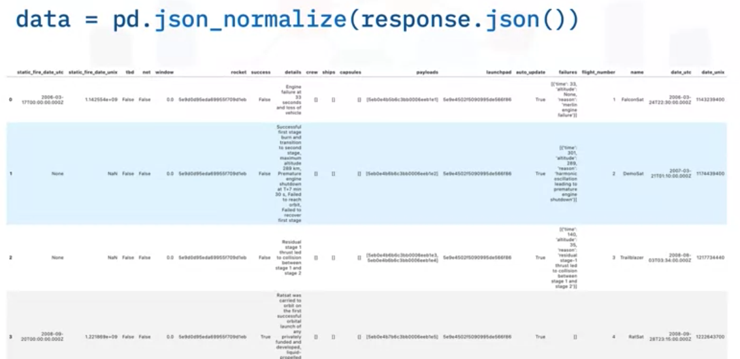
Data Collection Overview
Convert this JSON to a dataframe, we can use the json_normalize function➔ a table form
Collecting the Data

Slide 7
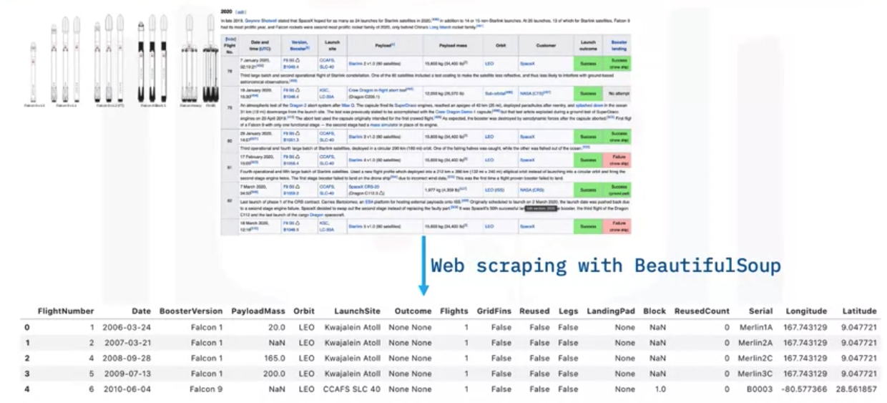
Data Collection Overview
Another popular data source for obtaining Falcon 9 Launch data is web scraping related Wiki pages: using the Python BeautifulSoup package
Collecting the Data

Slide 8
Data Collection Overview
Raw data: transform to clean dataset:
  Wrangling Data using an API
  Sampling Data
  Dealing with Nulls.
Sometimes we need to use the API again targeting another endpoint to gather specific data for each ID number.
Collecting the Data

Slide 9
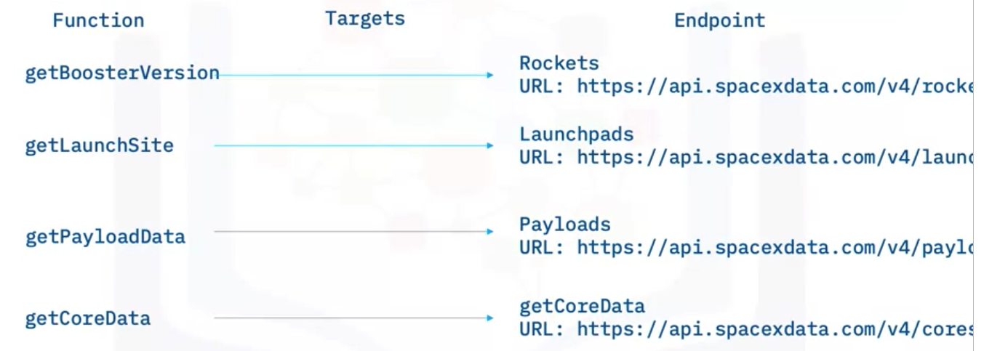
Data Collection Overview
The data we needed: Booster, Launchpad, payload, and core
Collecting the Data

Slide 10
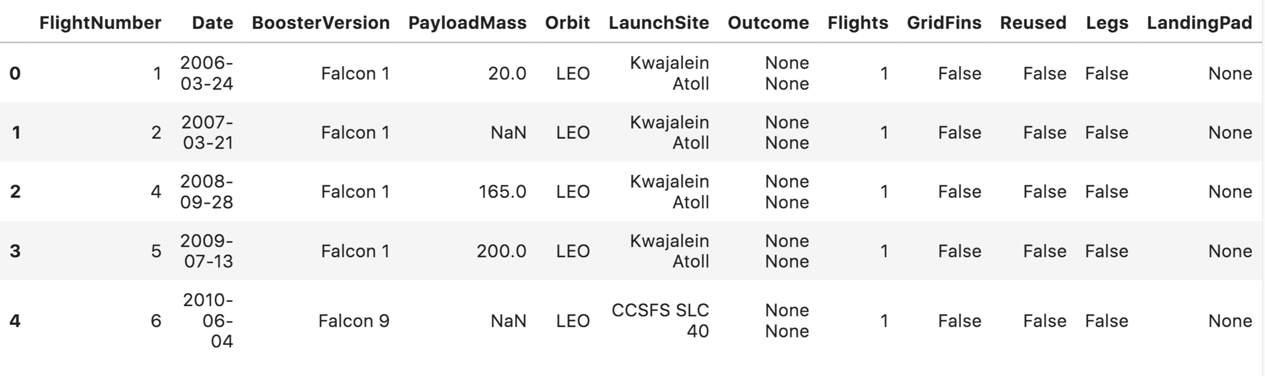
Data Collection Overview
Another issue is that the launch data we have includes data for the Falcon 1 booster whereas we only want falcon 9.
We only keep information related to Falcon 9
Collecting the Data

Slide 11
Data Collection Overview
Not all gathered data is perfect: contains NULL values.
NULL values inside the PayloadMass: calculate the mean of the PayloadMass data and then replace the null values in PayloadMass with the mean.
We will leave the column LandingPad with NULL values, as it is represented when a landing pad is not used.
Collecting the Data

Slide 12
Implement the Data Collection API
Student task: Import and complete the below Jupyter notebook in IBM Watson Studio
→ jupyter-labs-spacex-data-collection-api.ipynb
Show your results
Collecting the Data
Notes:
https://cf-courses-data.s3.us.cloud-object-storage.appdomain.cloud/IBM-DS0321EN-SkillsNetwork/labs/module_1_L2/jupyter-labs-spacex-data-collection-api.ipynb

Slide 13
Summary
Data Collection Overview
Implement the Data Collection API
Collecting the Data

Slide 14
Q & A
Collecting the Data

